Slide 1

Machine Learning techniques applied to neutrinos recognition
- A KM3Net Collaboration -
Louis Lovat
Mathieu Lamoureux
Gwenhaël de Wasseige

Slide 2
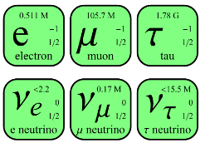
About neutrinos…
Fundamental particles of the standard model
3 flavours
Nearly no interaction

Slide 3
About neutrinos…
VERY interesting
Many unknowns to investigate
Carry information from faraway universe

Slide 4
About their detection…
Cherenkov effect

Slide 5
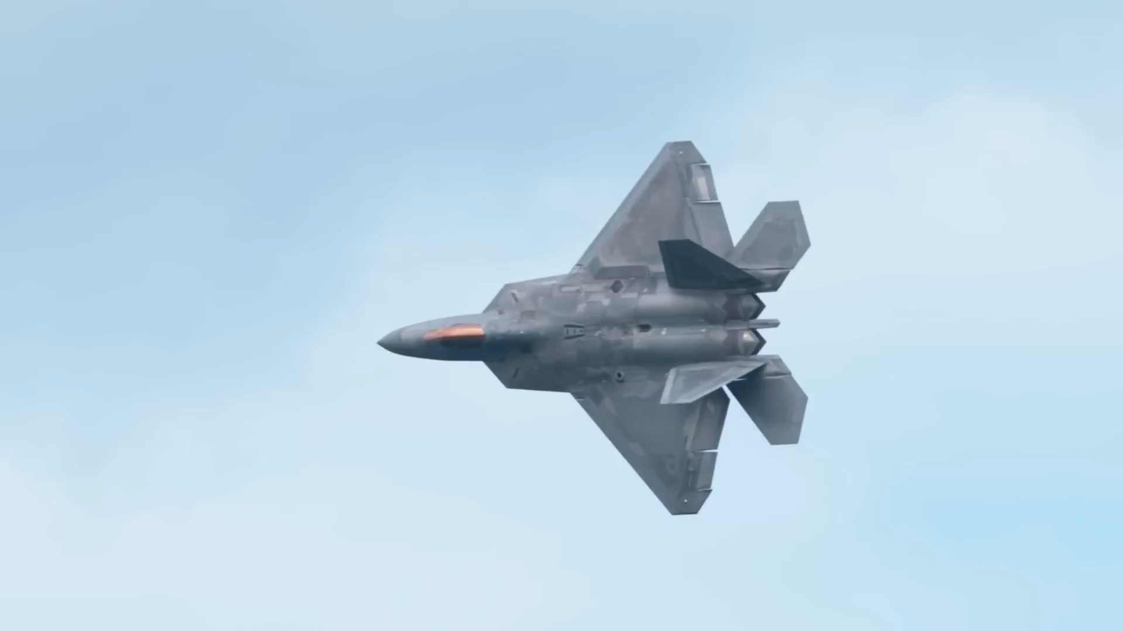
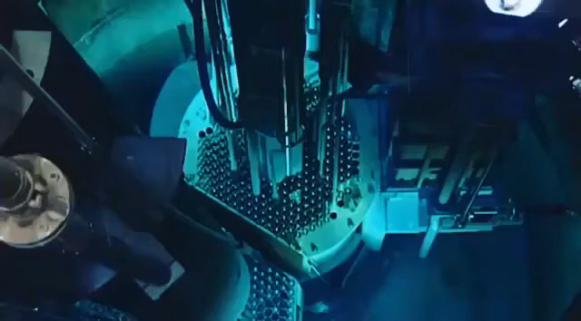
About their detection…
Cherenkov effect

Slide 6
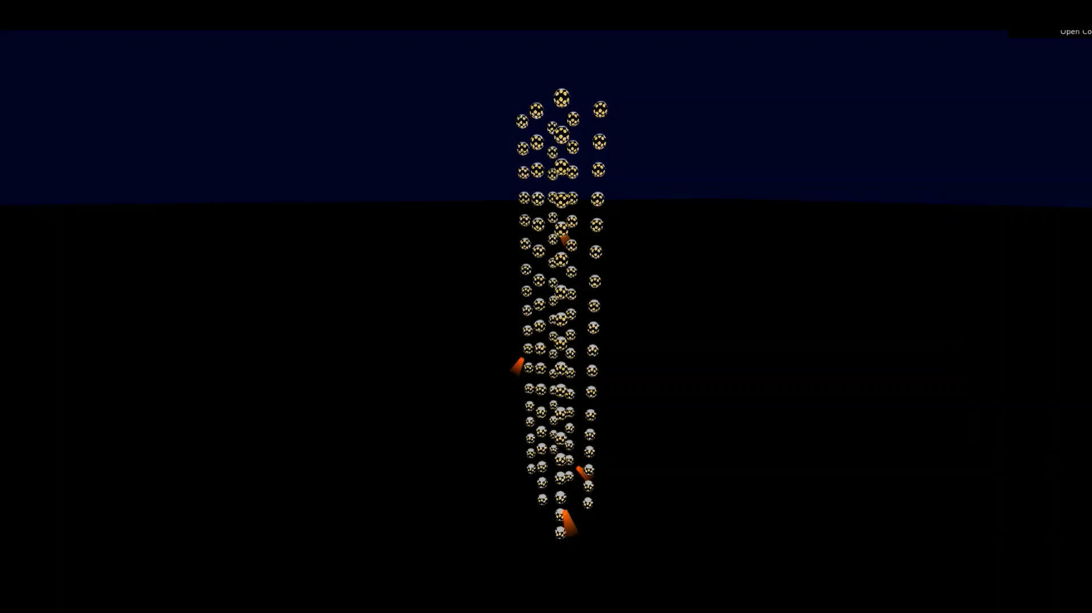
About their detection…
→ Indirect detection…

Slide 7
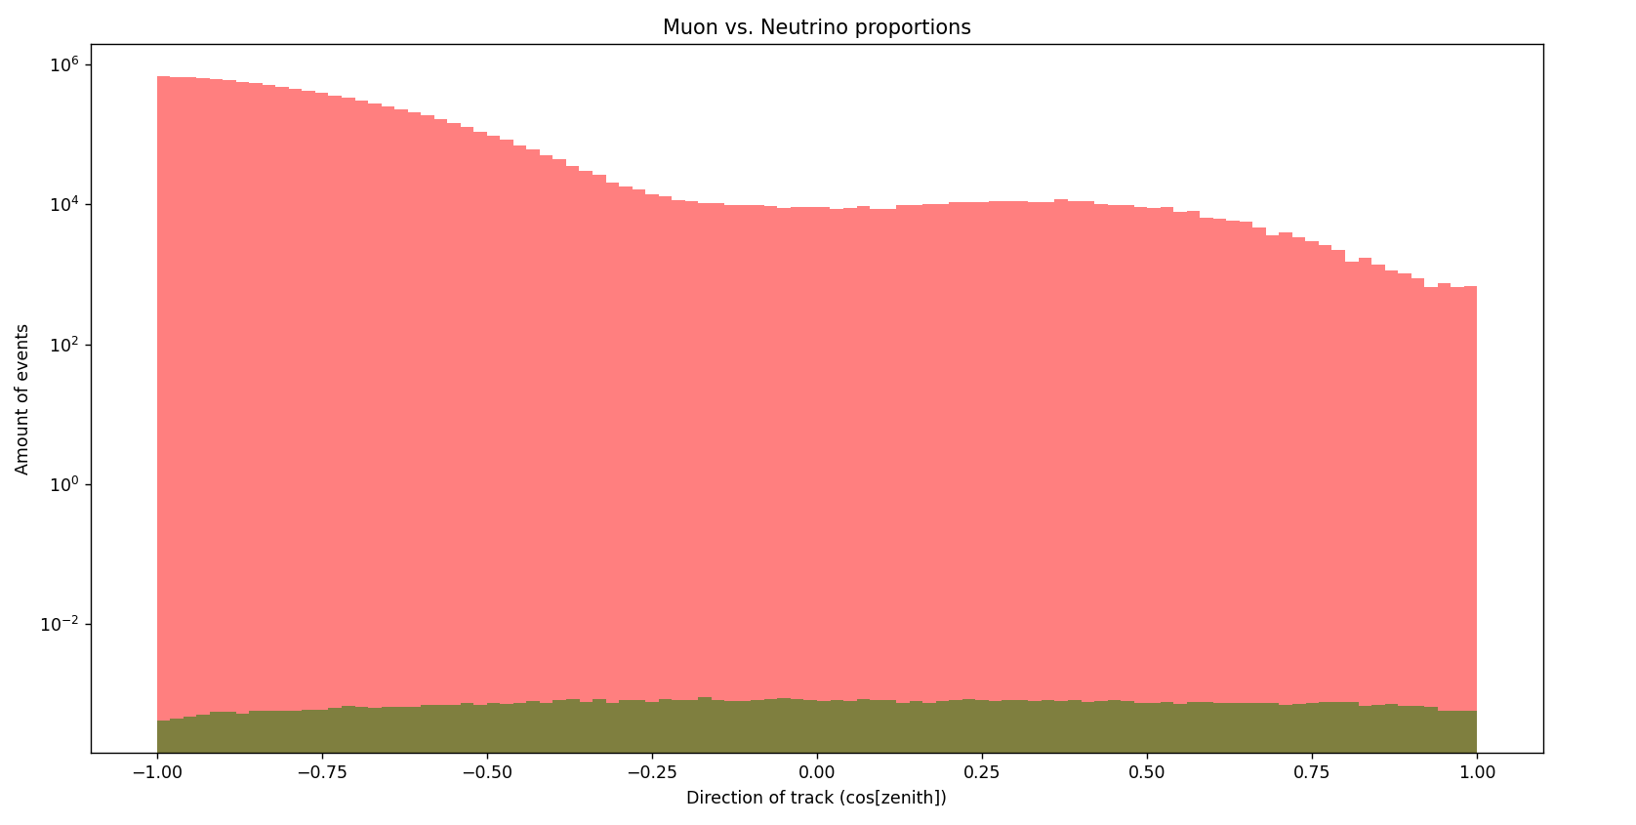
Distinguishing a neutrino from a muon…
… That’s looking for a needle in a haystack.

Slide 8
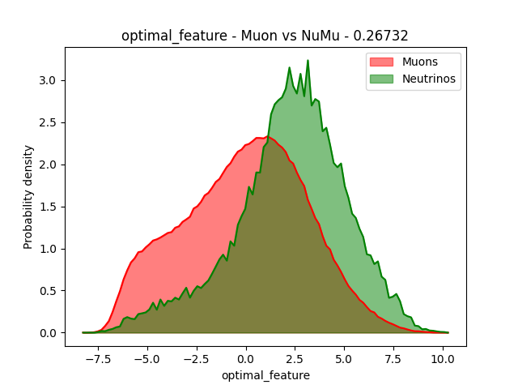
Assembling features
Energy of particles
Repartition of photons in detector
Length of the track
…

Slide 9
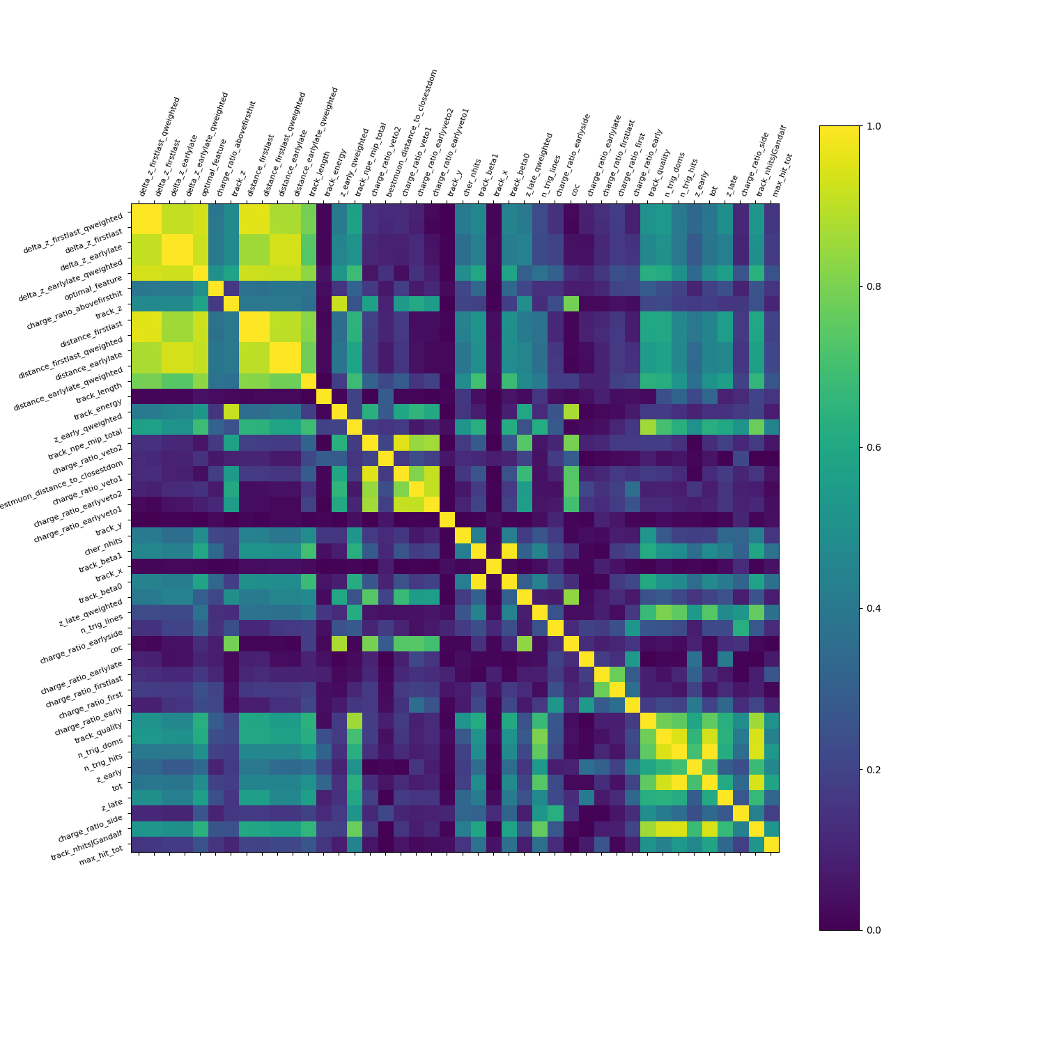
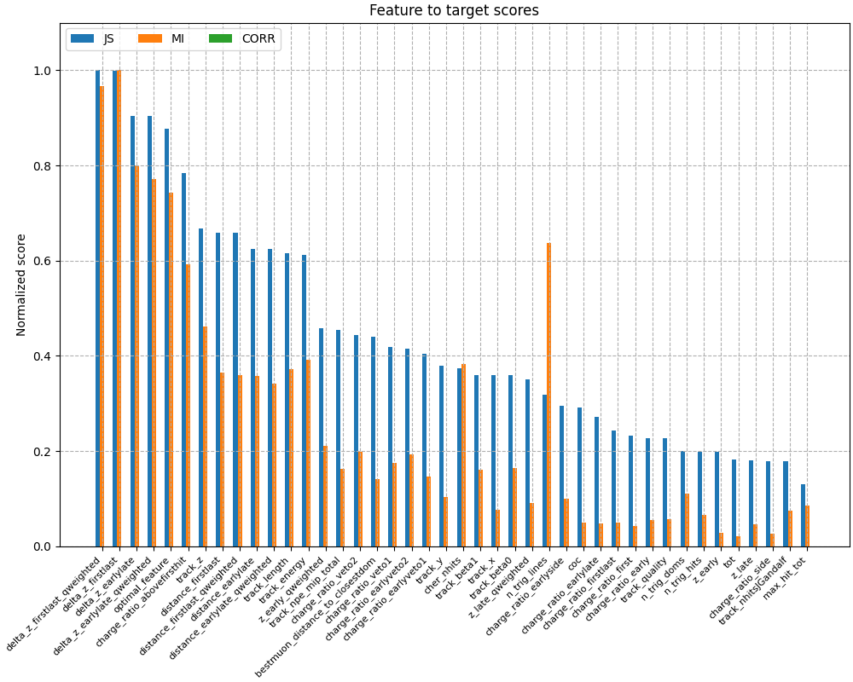
Selecting features

Slide 10
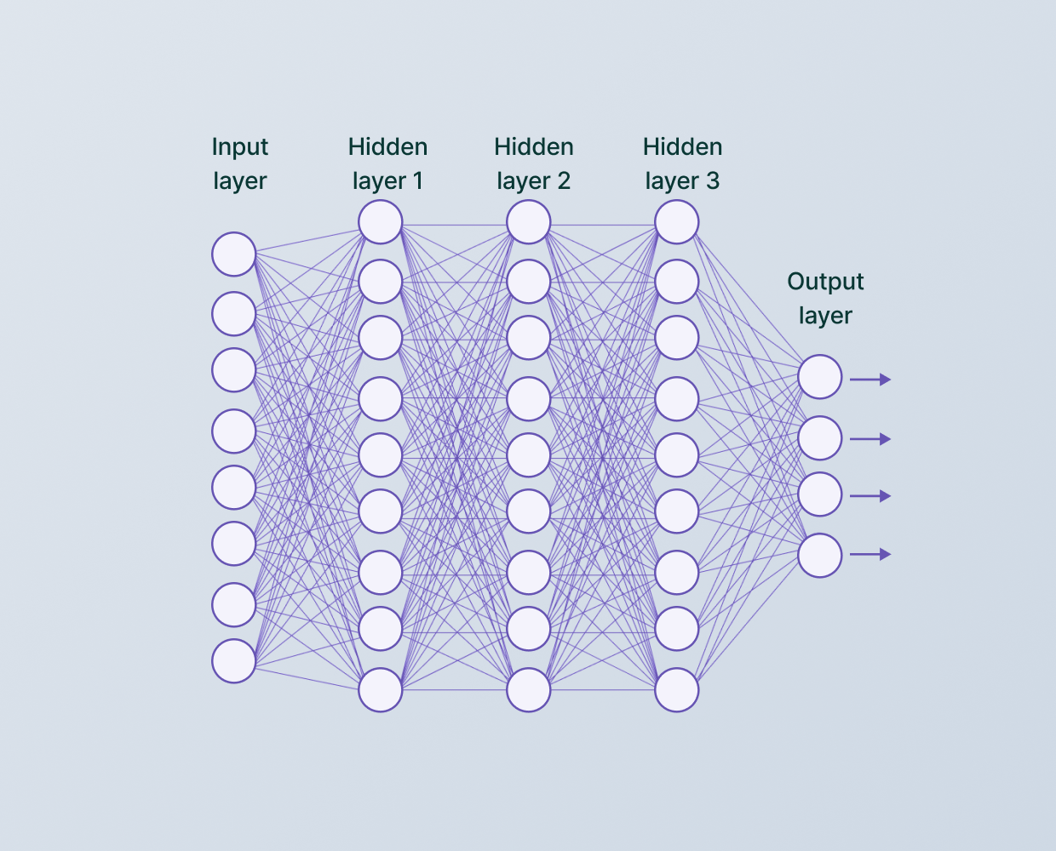
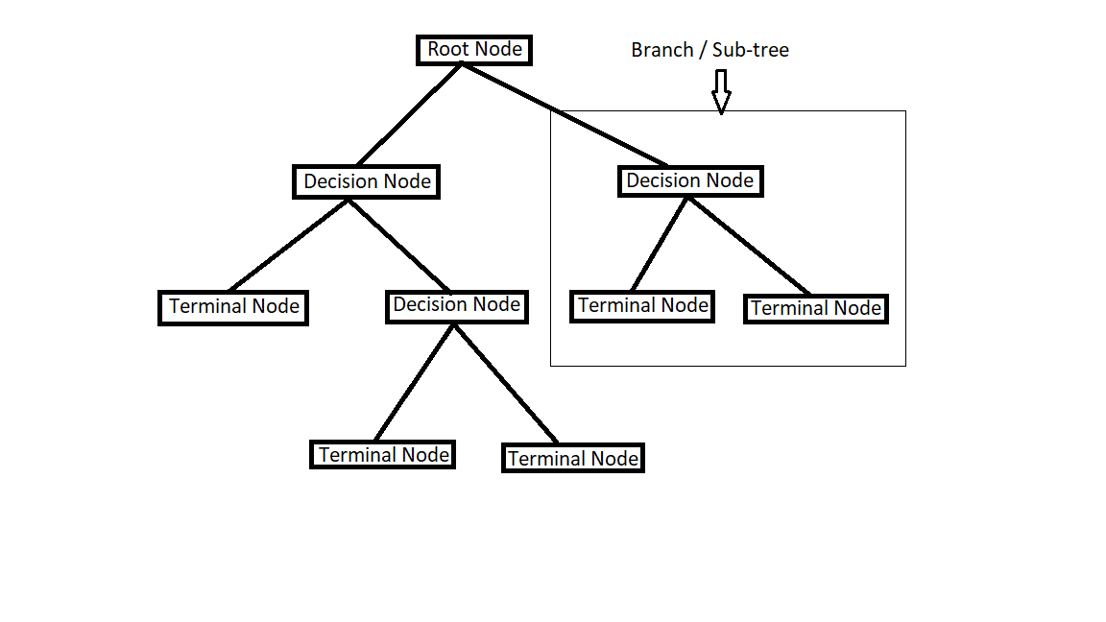
Training a model

Slide 11
Thank you
for your attention

